Slide 1



RecSys – DK
Johannes Kruse
@EkstraBladet

Slide 2
Agenda
Ekstra Bladet & PIN
Challenges for News Recommendations
Project: RRS-DK
Responsible Recommender Systems for Danish News Publishing
Latest work
Current work
Importance of beyond accucary / metrics

Slide 3
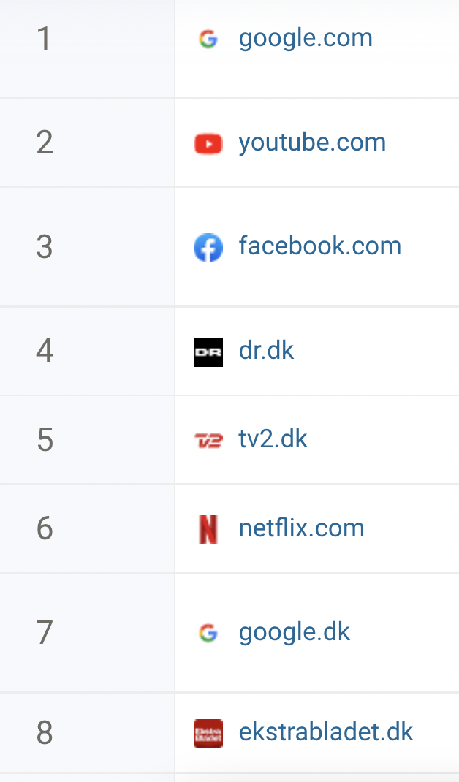
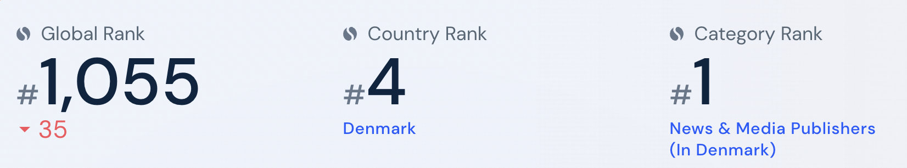
Danish News Publisher
Text-driven; starting to do audio & video
8th Most Visited Websites by Traffic in the Denmark¹
1 million daily users
450+ mio pageviews per month
1 https://www.similarweb.com/top-websites/denmark/ (07/06/22)
Notes:
Image udadtil ikke det samme som image indadtil

Slide 4
Platform Intelligence News
Ekstra Bladet
DTU Compute
(assoc. prof. Jes Frellsen)
Computer Science at UCPH
(prof. Anders Søgaard)
MSC at CBS
(prof. Mikkel Flyverbom)
Media and Communi-cation at UCPH
(assoc. prof. Stine Lomborg)
RRS-DK: Responsible Recommender Systems for Danish News Publishing
Collaboration with leading researchers at Danish universities
Ekstra Bladet defines and lead the research projects
Strives for a holistic approach (full picture)
Fund: IFD’s Grand Solutions program (1,5 mil euro) and Industrial PhD programme (0,5 mil. euro)

Slide 5
Research Questions
Ongoing
1. Baseline
2. Improve
3. Explainability
RQ1: How well does state-of-the-art RS for news from the perform in a Ekstra Bladet setting?
RQ2: By how much can the SOTA RS for Ekstra Bladet news?
RQ3: How can the predictions of RS based on deep neural nets best be explained?

Slide 6

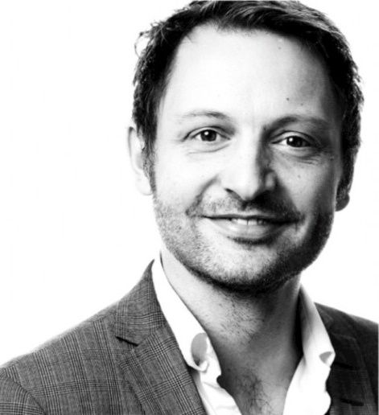
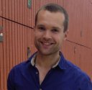

RSS-DK – Supervisors
Jes Frellsen
Assoc. Prof.
jefr@dtu.dk
Kasper Lindskow
Head of Research and Innovation at EB
kasper.lindskow@eb.dk
Michael Riis Andersen
Assoc. Prof.
miri@dtu.dk
Lars Kai Hansen
Prof.
lkai@dtu.dk

Slide 7
News Recommendations – Challenges
New news articles are posted continuously and expires fast
Severe cold-start problem (e.g. Ekstra Bladet publish up to 350 articles daily)
User preferences and indirect and (might) change with the news agenda
News articles contain rich textual information such as title and body
Requires extensive pre-processing (IDs not appropriate), e.g., NLP techniques
AI alignment challenge
Existing RS models are not necessarily aligned with news publishers’ values and goals
Click behaviors in an implicit proxy in regards of user interest
Survival time (time interval between first and last appearance) of more than 84.5% news articles in MIND is less than two days
User interests are usually diverse and dynamic (mood, time a day, device)
Technical
There are no general Recommender System framework that everyone is following
Notes:
“If you can’t measure it, you can’t improve it” — Peter Drucker
Formulated by MIND competition
(Could give potential cold-start)

Slide 8


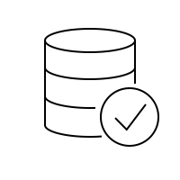
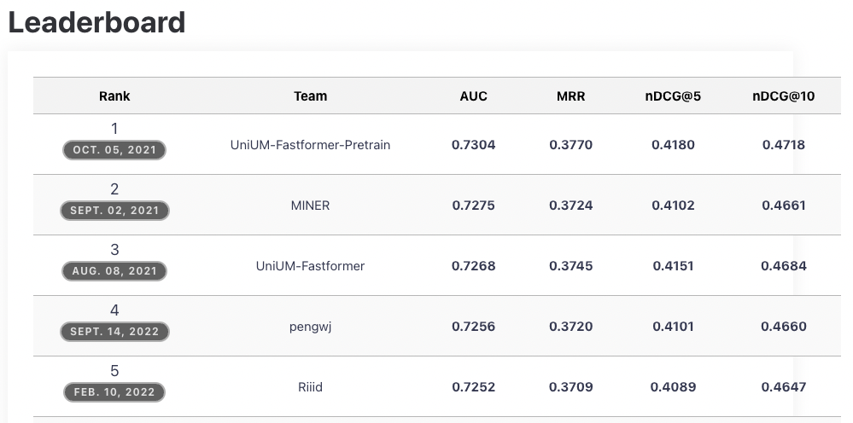
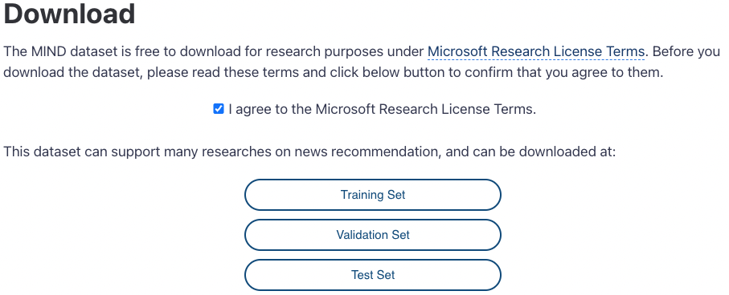
MIND Challenge

Slide 9
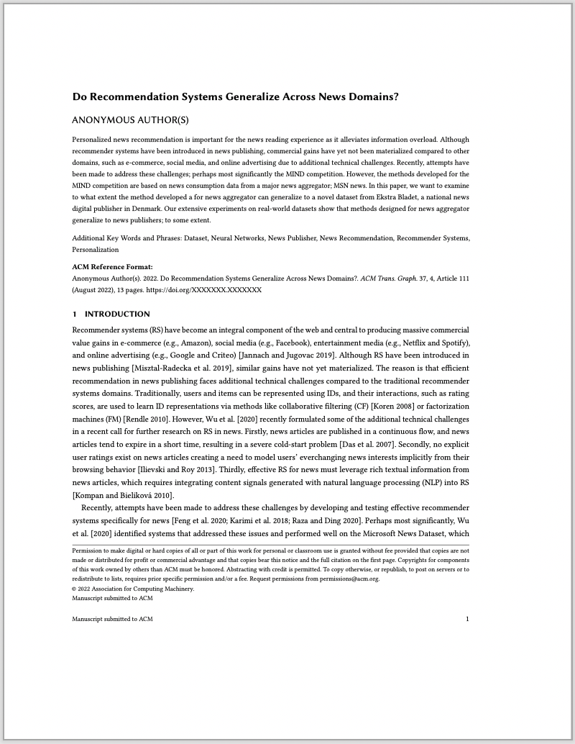
Do Recommendation Systems Generalize Across News Domains?
Benchmark paper
Baseline for future work
Submitted to RecSys 2022 (Seattle)
Not Accepted

Slide 10
Do Recommendation Systems Generalize Across News Domains?
Assumption
Methods developed for the MIND competition are based on news consumption data from a major news aggregator; MSN news.
Motivation
Examine to what extent the method developed a for news aggregator (and other purposes) can generalize to a novel dataset from Ekstra Bladet
Finding
“The main finding of our research is that methods designed for a news aggregator generalize to news publishes; to some extent.”

Slide 11
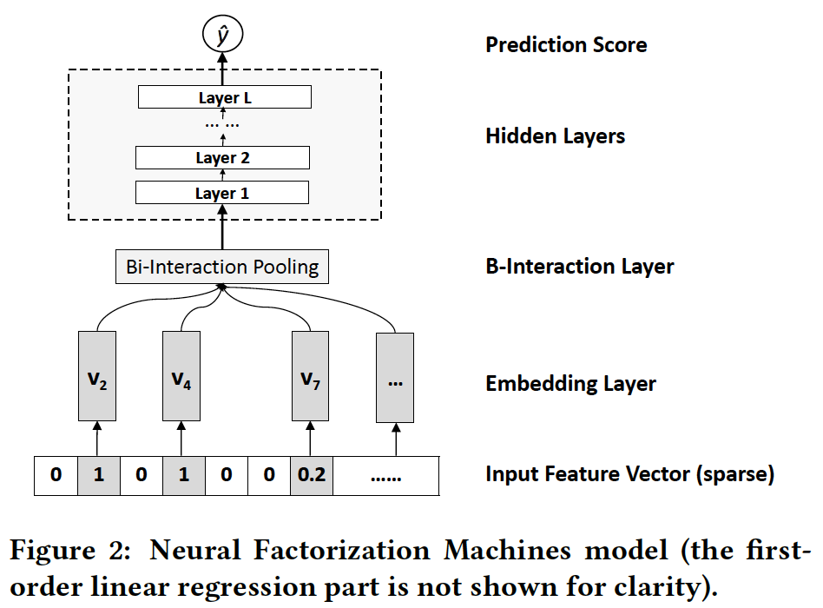
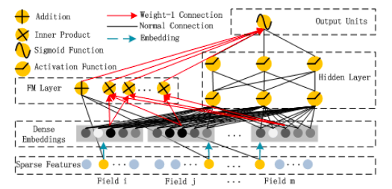
General Recommendation Methods
STACKED
PARALLEL
NFM (He et al. 2017)
DeepFM (Guo et al. 2017)
Rely on multiple features to make recommendations
https://github.com/shenweichen/DeepCTR-Torch

Slide 12
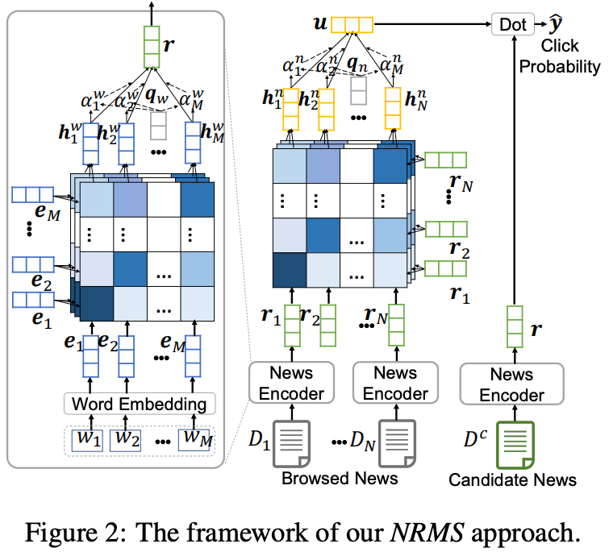
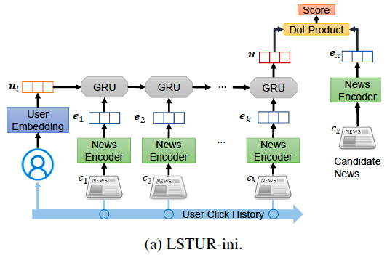
News Recommendation Methods
(-) LONG-TERM EMBEDDING
(+) LONG-TERM EMBEDDING
Wu et al. 2019
An et al. 2019
Developed based on news consumption data from a major news aggregator; MSN news
https://github.com/microsoft/recommenders

Slide 13

Have we missed something?

Slide 14
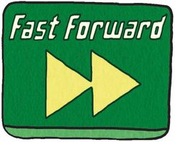
Today…

Slide 15
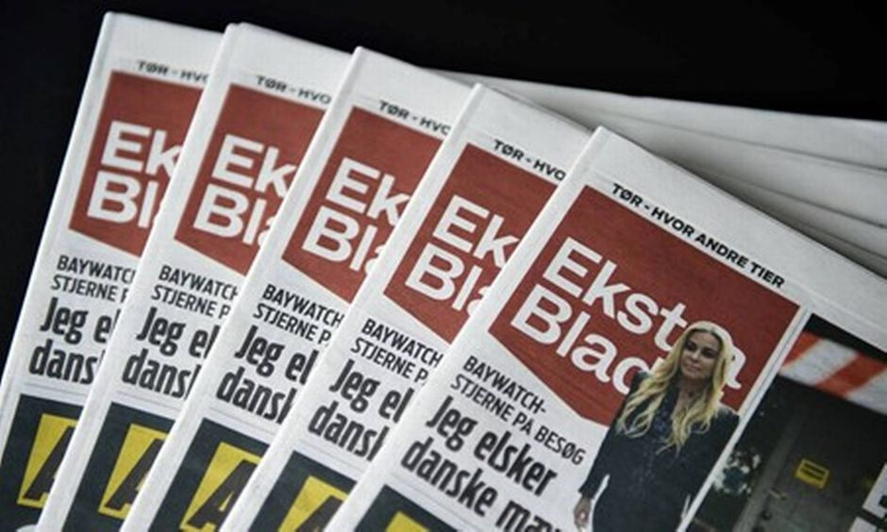

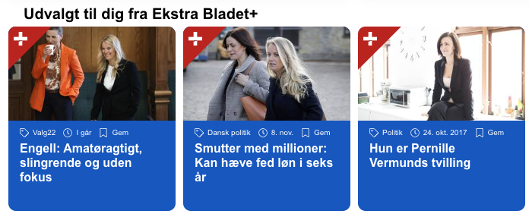
Open-source Dataset
Release: 2023
“EB-News” (dataset)
EB-Competition
Format…

Slide 16
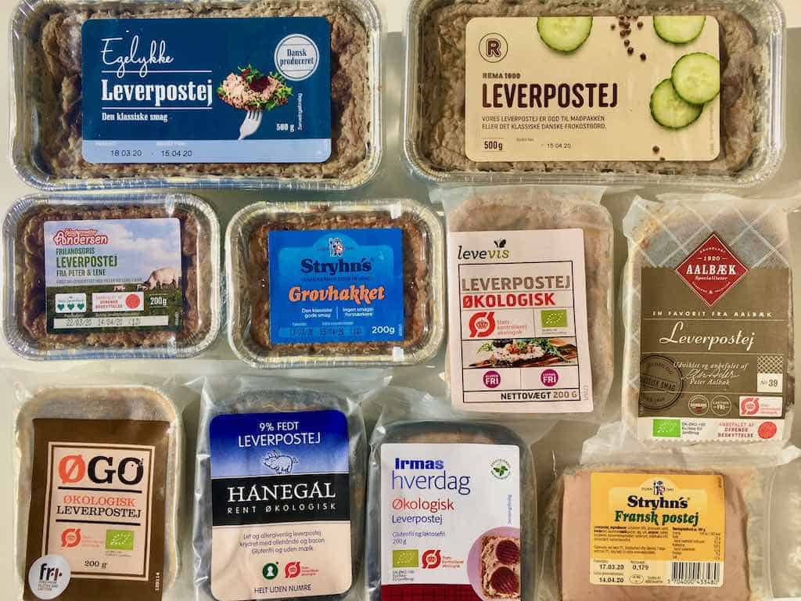
Evaluation Framework
Beyond Accuracy
Diversity
Serendipity
Coverage
Popularity
Others?
DeepFM (Guo et al. 2017)

Slide 17
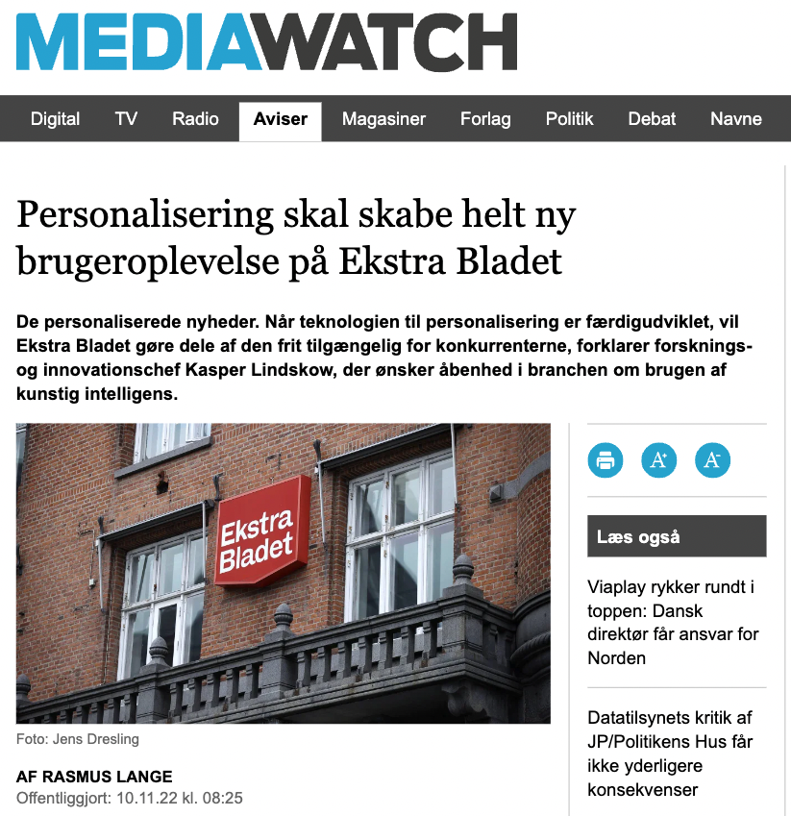

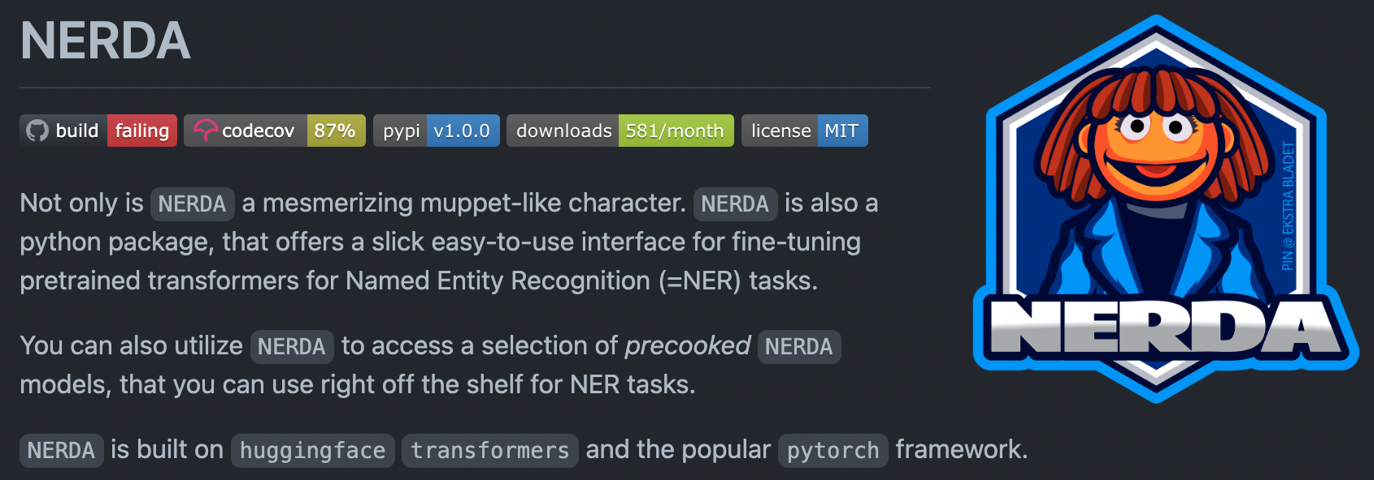
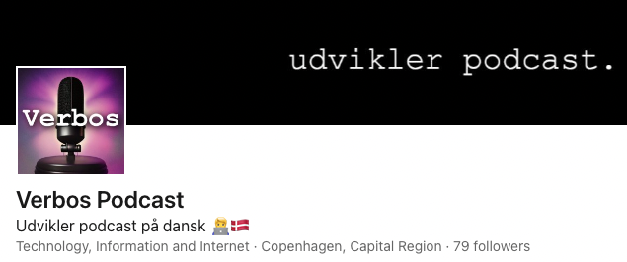
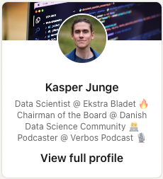


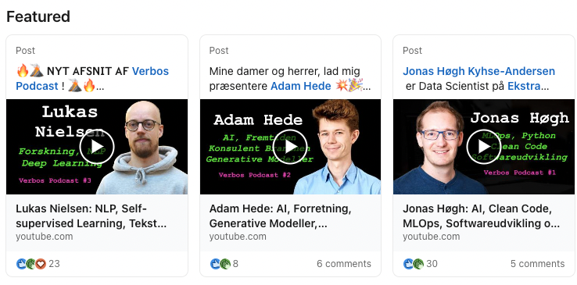
Transparency…

Slide 18
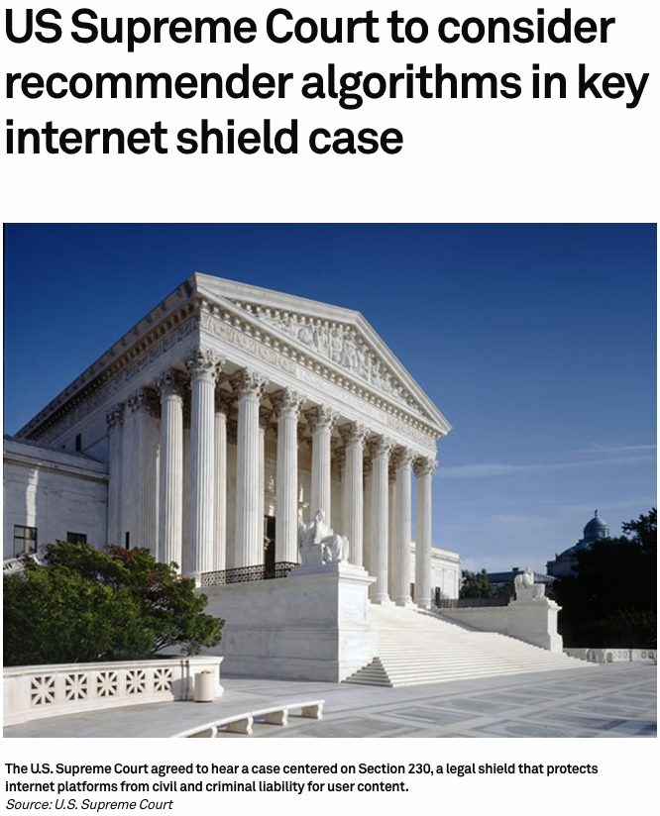
Accountability…
“In the case, the Gonzalez family argues Google should be liable for the promotion of an Islamic State recruitment video by its algorithms. The video is allegedly tied to a 2015 terror attack in Paris that killed 130 people, including 23-year-old Nohemi Gonzalez.”
4 Nov, 2022 – link

